Slide 1
Retail Sales and Inventory Management
Submitted by: Vighneswar Anil

Slide 2
Problem Overview
Retailers often struggle with inefficient processing of data, hindering effective sales and inventory management.
The solution aims to build a comprehensive data pipeline using Azure Data Factory for streamlined data ingestion.
We will store raw data in Azure Cosmos DB from multiple locations and PySpark for data cleaning and transformation. SQL-based materialized views will be created in Azure SQL Database for efficient reporting, Interactive dashboards in Databricks.

Slide 3
Details of Input Data
Sales Data
Contains daily sales data of a Turkish Retail Company from 2017 to 2019.
Columns:
store_id: Unique identifier for each store.
product_id: Unique identifier for each product.
date: Sales date (YYYY-MM-DD).
sales: Quantity of products sold.
revenue: Total revenue generated for the day.
stock: Stock quantity.
price: Sale price of the product.
promo_type_1: Type of promotion applied.
Additional promotion-related columns.

Slide 4
Details of Input Data
Product Data
Description: Provides details about product hierarchy and dimensions.
Columns:
product_id: Unique identifier for each product.
product_length: Length of the product.
product_depth: Depth of the product.
product_width: Width of the product.
Hierarchical identifiers.
Store Data
Description: Contains information about store locations and types.
Columns:
store_id: Unique identifier for each store.
city_id: Unique identifier for each city.
storetype_id: Identifier for the type of store.
store_size: Size of the store.

Slide 5
Tech Stack
Azure Data Factory
Azure Cosmos DB
Azure Blob Storage Service
Azure Databricks
Azure SQL service

Slide 6
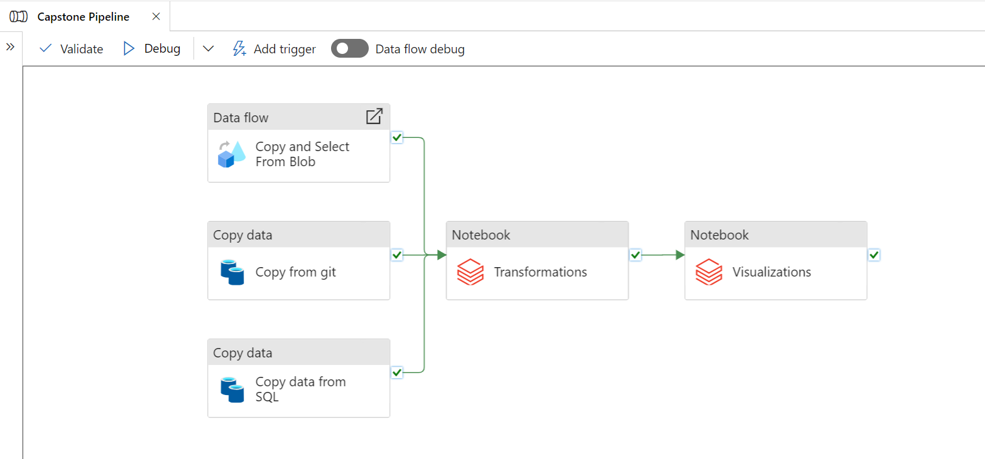
Pipeline

Slide 7
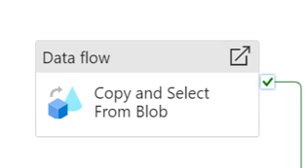
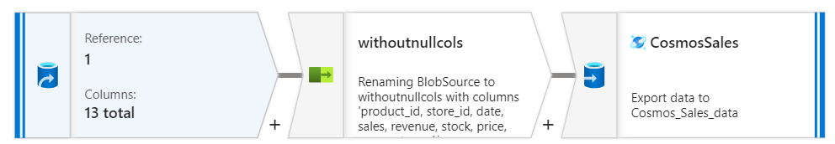

Slide 8
Transformations
Reading the Sales data from cosmos landing zone.
Checking inferred datatypes and making necessary typecasting
Dropping irrelevant columns
Optimisations
Checking Duplicates.
Count of Records
Checking for nulls and handling them
creating new columns from date
Reading Product Data from Landing Zone
Checking for nulls and handling them
Reading Store Data from the Landing Zone
Checking for nulls and handling them
Joining 3 Datasets into a single dataframe
Writing the Cleaned Data to Azure Blob Storage

Slide 9
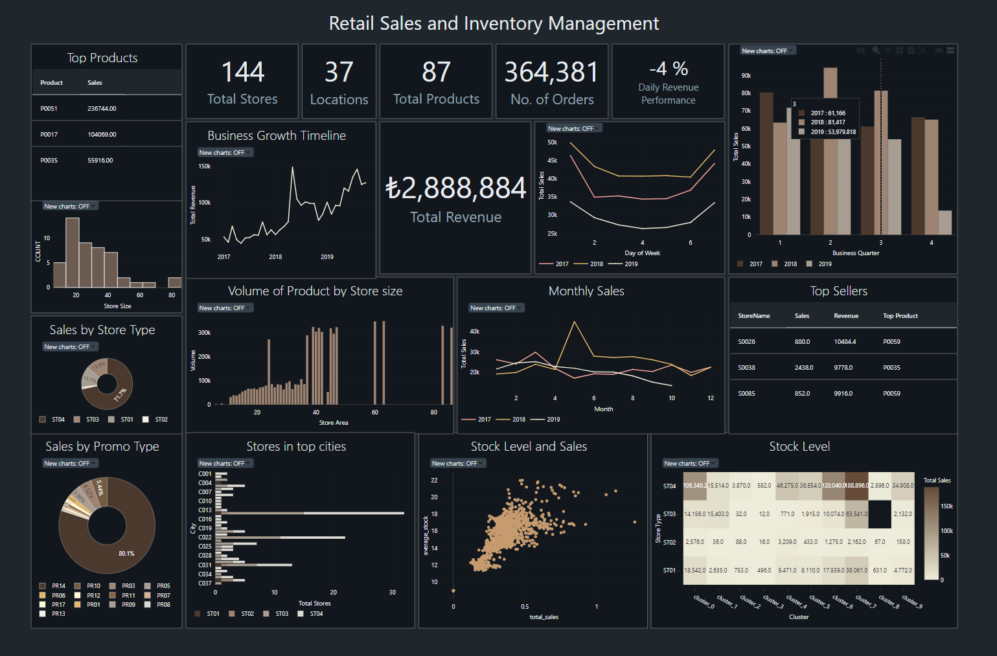
Dashboard

Slide 10
Insights
Weekends have higher no. of sales than weekdays
Stores with more area sell higher volume of products
Shops are Overstocked
Mid-size stores are more number
Most effective promotion is PR14
Shop type with most sales is ST04
P0051 is the Top Product
S0026 is the Top Seller
C014 has most no. of Stores

Slide 11
Solution Benefits
Increased Revenue: By leveraging data-driven insights, the retail company can optimize pricing, promotions, and product assortments, leading to higher sales and revenue growth.
Cost Savings: Improved inventory management minimizes excess stock and reduces storage costs, while efficient operations lower overall operational expenses.
Customer Satisfaction: Enhanced product availability and targeted promotions increase customer satisfaction and loyalty, leading to repeat business and positive brand perception.
Competitive Advantage: Real-time analytics and insights allow the company to quickly respond to market trends and consumer demands, providing a competitive edge over rivals.
Strategic Planning: Access to detailed performance metrics and trends supports better strategic planning and forecasting, enabling the company to set realistic goals and allocate resources effectively.

Slide 12
Challenges Faced
Large Quantity of Data
Lack of Context
Resource Limitations and Restrictions

Slide 13

Thank You!

